Slide 1

DIVINE GRACE COLLEGE OF ARTS, SCIENCE AND TECHNOLOGY
(DGCAST) — GAROUA | GEOGRAPHY DEPARTMENT
UPPER SIXTH ARTS — ECONOMIC GEOGRAPHY — LESSON 4
Agriculture as a System and its Classification
Mr KAMDEM EMMANUEL
Geography Teacher — PLEG
Academic Year 2026 / 2027
Notes:
Good morning, class. Today we study Lesson 4: Agriculture as a System and its Classification.

Slide 2
GEOGRAPHY — UPPER SIXTH ARTS
CLASS INFO
Class, Chapter & Duration
Class | Upper Sixth Arts
Chapter | Module 6: Understanding and managing the dynamics of economic activities across the world in general and Cameroon in particular
Duration | 2 periods (2 × 50 minutes)
2026 / 2027
DGCAST GAROUA — GEOGRAPHY DEPARTMENT
Mr KAMDEM E. | 2

Slide 3
GEOGRAPHY — UPPER SIXTH ARTS
IDENTIFICATION
Lesson Identification
Topic | Agricultural Systems
Sub-topic | The Agricultural Systems
Lesson | Lesson 4: Agriculture as a System and its Classification
Notions / Concepts | Farm system, inputs, processes, outputs, feedback, classification criteria.
Syllabus focus | Agriculture as a system of production; bases of classifying agriculture.
Competence | Learners are able to describe a farm as a system and explain the bases of classification.
2026 / 2027
DGCAST GAROUA — GEOGRAPHY DEPARTMENT
Mr KAMDEM E. | 3

Slide 4
GEOGRAPHY — UPPER SIXTH ARTS
OBJECTIVES
Learning Objectives
By the end of the lesson, the learner should be able to:
Describe the farm as a system.
Identify inputs, processes, outputs and feedback.
Explain the bases of classifying agriculture.
2026 / 2027
DGCAST GAROUA — GEOGRAPHY DEPARTMENT
Mr KAMDEM E. | 4

Slide 5
GEOGRAPHY — UPPER SIXTH ARTS
RECALL
Recall
A drainage basin is a system.
Farming uses land, labour and capital.
2026 / 2027
DGCAST GAROUA — GEOGRAPHY DEPARTMENT
Mr KAMDEM E. | 5

Slide 6
GEOGRAPHY — UPPER SIXTH ARTS
REAL-LIFE SITUATION
Real-Life Situation
A cocoa farmer uses land, family labour, seedlings and fungicides. He harvests cocoa, sells it and uses the money to buy more fungicides the next year.
2026 / 2027
DGCAST GAROUA — GEOGRAPHY DEPARTMENT
Mr KAMDEM E. | 6
Notes:
Read the situation slowly, twice.

Slide 7
GEOGRAPHY — UPPER SIXTH ARTS
REAL-LIFE SITUATION
Situation — Question 1
What is the problem in the situation?
2026 / 2027
DGCAST GAROUA — GEOGRAPHY DEPARTMENT
Mr KAMDEM E. | 7

Slide 8
GEOGRAPHY — UPPER SIXTH ARTS
REAL-LIFE SITUATION
Answer
Learners want to see the farm as a system.
2026 / 2027
DGCAST GAROUA — GEOGRAPHY DEPARTMENT
Mr KAMDEM E. | 8

Slide 9
GEOGRAPHY — UPPER SIXTH ARTS
REAL-LIFE SITUATION
Situation — Question 2
Name two inputs.
2026 / 2027
DGCAST GAROUA — GEOGRAPHY DEPARTMENT
Mr KAMDEM E. | 9

Slide 10
GEOGRAPHY — UPPER SIXTH ARTS
REAL-LIFE SITUATION
Answer
Land and labour (also seedlings, fungicides).
2026 / 2027
DGCAST GAROUA — GEOGRAPHY DEPARTMENT
Mr KAMDEM E. | 10

Slide 11
GEOGRAPHY — UPPER SIXTH ARTS
REAL-LIFE SITUATION
Situation — Question 3
What is the feedback?
2026 / 2027
DGCAST GAROUA — GEOGRAPHY DEPARTMENT
Mr KAMDEM E. | 11

Slide 12
GEOGRAPHY — UPPER SIXTH ARTS
REAL-LIFE SITUATION
Possible Answer
Money from sales is reinvested in the farm.
2026 / 2027
DGCAST GAROUA — GEOGRAPHY DEPARTMENT
Mr KAMDEM E. | 12

Slide 13
GEOGRAPHY — UPPER SIXTH ARTS
JUSTIFICATION
Justification of the Lesson
This lesson helps us to analyse and classify farming systems.
2026 / 2027
DGCAST GAROUA — GEOGRAPHY DEPARTMENT
Mr KAMDEM E. | 13

Slide 14
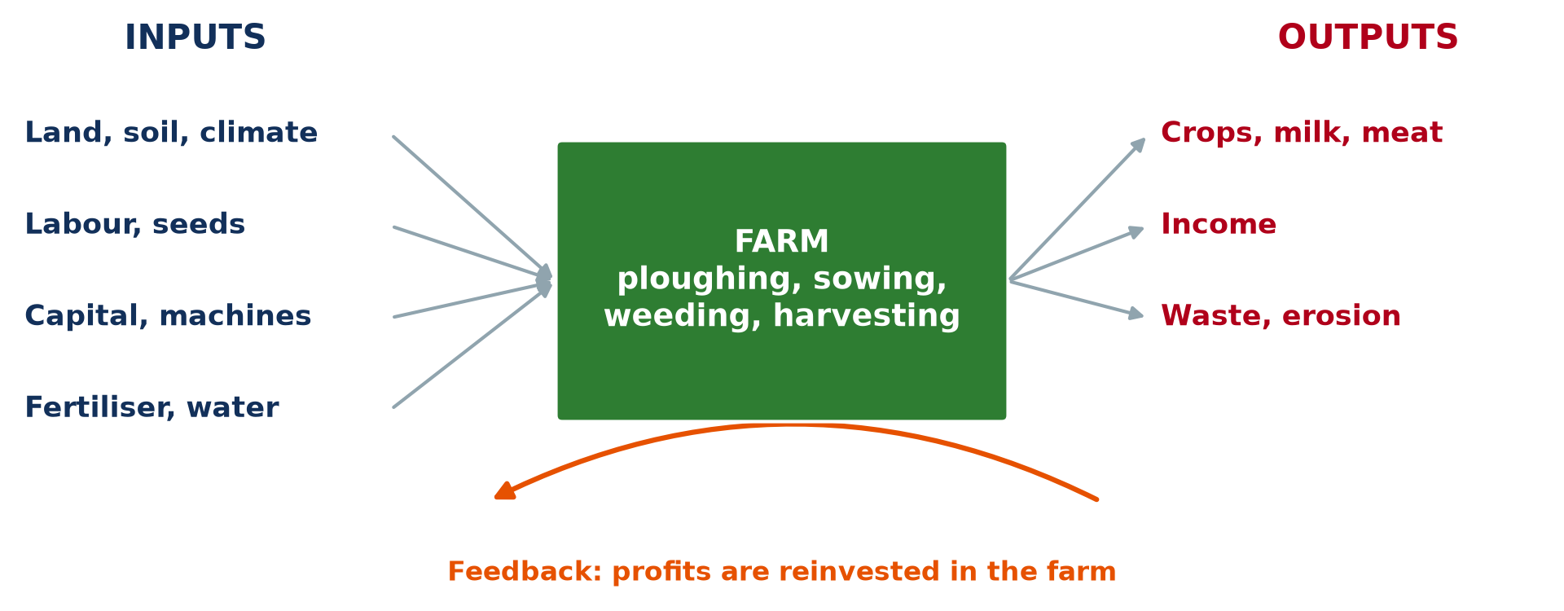
GEOGRAPHY — UPPER SIXTH ARTS
I. THE SYSTEM
Activity 1
The farm as a system.
2026 / 2027
DGCAST GAROUA — GEOGRAPHY DEPARTMENT
Mr KAMDEM E. | 14
Notes:
Without the projector: draw the system.

Slide 15
GEOGRAPHY — UPPER SIXTH ARTS
I. THE SYSTEM
Activity 1: Question
Name two inputs, two processes and two outputs of a farm.
2026 / 2027
DGCAST GAROUA — GEOGRAPHY DEPARTMENT
Mr KAMDEM E. | 15

Slide 16
GEOGRAPHY — UPPER SIXTH ARTS
I. THE SYSTEM
Answer
Inputs: land, labour. Processes: sowing, harvesting. Outputs: crops, income.
2026 / 2027
DGCAST GAROUA — GEOGRAPHY DEPARTMENT
Mr KAMDEM E. | 16

Slide 17

GEOGRAPHY — UPPER SIXTH ARTS
I. THE SYSTEM
Activity 2
Cocoa beans drying.
2026 / 2027
DGCAST GAROUA — GEOGRAPHY DEPARTMENT
Mr KAMDEM E. | 17
Notes:
Without the projector: list steps of cocoa farming.

Slide 18
GEOGRAPHY — UPPER SIXTH ARTS
I. THE SYSTEM
Activity 2: Question
Which process is shown in the photo?
2026 / 2027
DGCAST GAROUA — GEOGRAPHY DEPARTMENT
Mr KAMDEM E. | 18

Slide 19
GEOGRAPHY — UPPER SIXTH ARTS
I. THE SYSTEM
Answer
Drying cocoa beans after harvest.
2026 / 2027
DGCAST GAROUA — GEOGRAPHY DEPARTMENT
Mr KAMDEM E. | 19

Slide 20
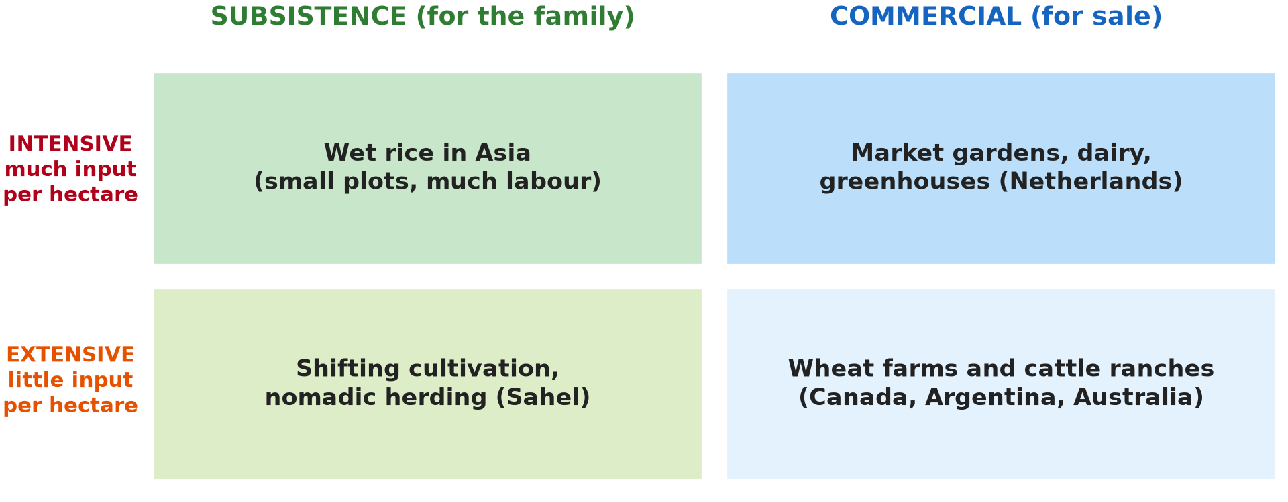
GEOGRAPHY — UPPER SIXTH ARTS
II. CLASSIFICATION
Activity 3
Four types of farming.
2026 / 2027
DGCAST GAROUA — GEOGRAPHY DEPARTMENT
Mr KAMDEM E. | 20
Notes:
Without the projector: list the bases.

Slide 21
GEOGRAPHY — UPPER SIXTH ARTS
II. CLASSIFICATION
Activity 3: Question
Give three bases for classifying agriculture.
2026 / 2027
DGCAST GAROUA — GEOGRAPHY DEPARTMENT
Mr KAMDEM E. | 21

Slide 22
GEOGRAPHY — UPPER SIXTH ARTS
II. CLASSIFICATION
Answer
Amount of inputs, purpose (subsistence or commercial), level of technology.
2026 / 2027
DGCAST GAROUA — GEOGRAPHY DEPARTMENT
Mr KAMDEM E. | 22

Slide 23

GEOGRAPHY — UPPER SIXTH ARTS
II. CLASSIFICATION
Activity 4
A combine harvester.
2026 / 2027
DGCAST GAROUA — GEOGRAPHY DEPARTMENT
Mr KAMDEM E. | 23
Notes:
Without the projector: compare hoe and tractor.

Slide 24
GEOGRAPHY — UPPER SIXTH ARTS
II. CLASSIFICATION
Activity 4: Question
Which basis of classification does this machine illustrate?
2026 / 2027
DGCAST GAROUA — GEOGRAPHY DEPARTMENT
Mr KAMDEM E. | 24

Slide 25
GEOGRAPHY — UPPER SIXTH ARTS
II. CLASSIFICATION
Answer
The level of technology (and capital input).
2026 / 2027
DGCAST GAROUA — GEOGRAPHY DEPARTMENT
Mr KAMDEM E. | 25

Slide 26

GEOGRAPHY — UPPER SIXTH ARTS
II. CLASSIFICATION
Activity 5
A mixed farm.
2026 / 2027
DGCAST GAROUA — GEOGRAPHY DEPARTMENT
Mr KAMDEM E. | 26
Notes:
Without the projector: give examples.

Slide 27
GEOGRAPHY — UPPER SIXTH ARTS
II. CLASSIFICATION
Activity 5: Question
How can the number of products classify farms?
2026 / 2027
DGCAST GAROUA — GEOGRAPHY DEPARTMENT
Mr KAMDEM E. | 27

Slide 28
GEOGRAPHY — UPPER SIXTH ARTS
II. CLASSIFICATION
Answer
Monoculture grows one product; mixed farming combines several.
2026 / 2027
DGCAST GAROUA — GEOGRAPHY DEPARTMENT
Mr KAMDEM E. | 28

Slide 29
GEOGRAPHY — UPPER SIXTH ARTS
BOARD SUMMARY
Agriculture as a System and its Classification
Topic: Agricultural Systems
Sub-topic: The Agricultural Systems
Lesson 4: Agriculture as a System and its Classification
2026 / 2027
DGCAST GAROUA — GEOGRAPHY DEPARTMENT
Mr KAMDEM E. | 29
Notes:
Learners copy the board summary now. Give them enough time for each slide.

Slide 30
GEOGRAPHY — UPPER SIXTH ARTS
BOARD SUMMARY
I. Definitions
Farm system: It is a farm seen as inputs, processes and outputs linked together.
Feedback: It is when an output affects the inputs of the next season.
Monoculture: It is growing one crop over a large area.
2026 / 2027
DGCAST GAROUA — GEOGRAPHY DEPARTMENT
Mr KAMDEM E. | 30

Slide 31
GEOGRAPHY — UPPER SIXTH ARTS
BOARD SUMMARY
II. The Farm as a System (1/2)
A. Inputs: Physical inputs are land, soil and climate. Human inputs are labour, capital, seeds and fertiliser.
B. Processes: Ploughing, sowing, weeding, spraying and harvesting change inputs into products. Animals are fed and milked.
2026 / 2027
DGCAST GAROUA — GEOGRAPHY DEPARTMENT
Mr KAMDEM E. | 31

Slide 32
GEOGRAPHY — UPPER SIXTH ARTS
BOARD SUMMARY
II. The Farm as a System (2/2)
C. Outputs and feedback: Outputs are crops, animal products, income and waste. Profits or losses change the next year's inputs.
2026 / 2027
DGCAST GAROUA — GEOGRAPHY DEPARTMENT
Mr KAMDEM E. | 32

Slide 33
GEOGRAPHY — UPPER SIXTH ARTS
BOARD SUMMARY
III. Bases of Classification (1/3)
A. Inputs and technology: Intensive farms use much labour or capital per hectare, and extensive farms use little. Technology ranges from hoes to machines.
B. Purpose: Subsistence farmers feed their families, and commercial farmers sell. Many African farmers do both.
2026 / 2027
DGCAST GAROUA — GEOGRAPHY DEPARTMENT
Mr KAMDEM E. | 33

Slide 34
GEOGRAPHY — UPPER SIXTH ARTS
BOARD SUMMARY
III. Bases of Classification (2/3)
C. Products and origin: Farms are arable, pastoral or mixed. Crops are also grouped by their original home (tropical, temperate).
2026 / 2027
DGCAST GAROUA — GEOGRAPHY DEPARTMENT
Mr KAMDEM E. | 34

Slide 35
GEOGRAPHY — UPPER SIXTH ARTS
BOARD SUMMARY
III. Bases of Classification (3/3)
Copy the farm system.
2026 / 2027
DGCAST GAROUA — GEOGRAPHY DEPARTMENT
Mr KAMDEM E. | 35

Slide 36
GEOGRAPHY — UPPER SIXTH ARTS
FORMATIVE EVALUATION
Formative Evaluation 1
Describe a farm as a system.
2026 / 2027
DGCAST GAROUA — GEOGRAPHY DEPARTMENT
Mr KAMDEM E. | 36

Slide 37
GEOGRAPHY — UPPER SIXTH ARTS
FORMATIVE EVALUATION
Expected Answer
Inputs (land, labour, capital) go through processes (sowing, harvesting) to give outputs (crops, income), with feedback.
2026 / 2027
DGCAST GAROUA — GEOGRAPHY DEPARTMENT
Mr KAMDEM E. | 37

Slide 38
GEOGRAPHY — UPPER SIXTH ARTS
FORMATIVE EVALUATION
Formative Evaluation 2
Give three bases of classifying agriculture.
2026 / 2027
DGCAST GAROUA — GEOGRAPHY DEPARTMENT
Mr KAMDEM E. | 38

Slide 39
GEOGRAPHY — UPPER SIXTH ARTS
FORMATIVE EVALUATION
Expected Answer
Inputs, purpose, technology (also products, origin of plants).
2026 / 2027
DGCAST GAROUA — GEOGRAPHY DEPARTMENT
Mr KAMDEM E. | 39

Slide 40
GEOGRAPHY — UPPER SIXTH ARTS
REMEDIATION
Remediation
Fill in the blanks:
Land and labour are farm ______.
Crops and income are ______.
Growing one crop is ______.
2026 / 2027
DGCAST GAROUA — GEOGRAPHY DEPARTMENT
Mr KAMDEM E. | 40
Notes:
Answers: 1. inputs 2. outputs 3. monoculture

Slide 41
GEOGRAPHY — UPPER SIXTH ARTS
HOMEWORK
Homework
Draw your family farm (or a farm you know) as a system.
This prepares Lesson 5: Types of Agricultural Systems.
2026 / 2027
DGCAST GAROUA — GEOGRAPHY DEPARTMENT
Mr KAMDEM E. | 41
Notes:
This homework prepares the next lesson.

Slide 42
GEOGRAPHY — UPPER SIXTH ARTS
BILINGUAL GAME
Bilingual Game (Jeu Bilingue)
English | Français
System | Le système
Input | L'intrant
Output | La production
Feedback | La rétroaction
Monoculture | La monoculture
Harvest | La récolte
2026 / 2027
DGCAST GAROUA — GEOGRAPHY DEPARTMENT
Mr KAMDEM E. | 42
Notes:
Say the English word; learners give the French word, then the reverse.

Slide 43
GEOGRAPHY — UPPER SIXTH ARTS
LOGBOOK
Official Logbook (1/2)
Module / Topic | Agricultural Systems
Lesson Title | Lesson 4: Agriculture as a System and its Classification
Expected Learning Outcomes | Describe the farm as a system. Identify inputs, processes, outputs and feedback. Explain the bases of classifying agriculture.
Competence | Learners are able to describe a farm as a system and explain the bases of classification.
2026 / 2027
DGCAST GAROUA — GEOGRAPHY DEPARTMENT
Mr KAMDEM E. | 43

Slide 44
GEOGRAPHY — UPPER SIXTH ARTS
LOGBOOK
Official Logbook (2/2)
Matter Taught | I. Definitions: Farm system, Feedback, Monoculture; II. The Farm as a System: Inputs, Processes, Outputs and feedback; III. Bases of Classification: Inputs and technology, Purpose, Products and origin.
Evaluation | Formative evaluation (3 questions) and remediation exercise.
Homework | Draw your family farm (or a farm you know) as a system.
Enrolment / Present / Absent | ____ / ____ / ____
Achievement | To be completed by the teacher after the lesson.
2026 / 2027
DGCAST GAROUA — GEOGRAPHY DEPARTMENT
Mr KAMDEM E. | 44

Slide 45
GEOGRAPHY — UPPER SIXTH ARTS
TEACHER'S NOTE
Teacher's Note
Timing: Set-up, recall 8 min | Situation 8 min | 5 activities 30 min | Board summary (copying) 30 min | Evaluation, remediation 10 min | Homework, logbook 9 min | Spare 5 min
2026 / 2027
DGCAST GAROUA — GEOGRAPHY DEPARTMENT
Mr KAMDEM E. | 45

Slide 46
GEOGRAPHY — UPPER SIXTH ARTS
REFERENCES
References
National Geography Syllabus, Sixth Forms (Lower & Upper Sixth), MINESEC/IGE/IP-SS, August 2019 — Module 6 (Economic Geography).
Photo, Activity 2: “Farmer sun drying cocoa beans” by IITA Image Library, CC BY-NC 2.0, via Flickr (https://www.flickr.com/photos/45796762@N03/4598613756)
Photo, Activity 4: “John Deere Combine” by SnoShuu, CC BY-NC-ND 2.0, via Flickr (https://www.flickr.com/photos/85888233@N00/2776467094)
Photo, Activity 5: “Timid” by tricky (rick harrison), CC BY-NC-SA 2.0, via Flickr (https://www.flickr.com/photos/81851211@N00/205287304)
Diagrams and animations: drawn for this lesson (DGCAST Geography Department).
2026 / 2027
DGCAST GAROUA — GEOGRAPHY DEPARTMENT
Mr KAMDEM E. | 46

